Slide 1


DL
Convolutional Neural Network

Slide 2

What is CNN?
CNNs are basically layers of convolutions followed by subsampling and fully connected layers.
Intuitively speaking,
convolutions and subsampling layers works as feature extraction layers while a fully connected layer classifies which category current input belongs to using extracted features.

Slide 3
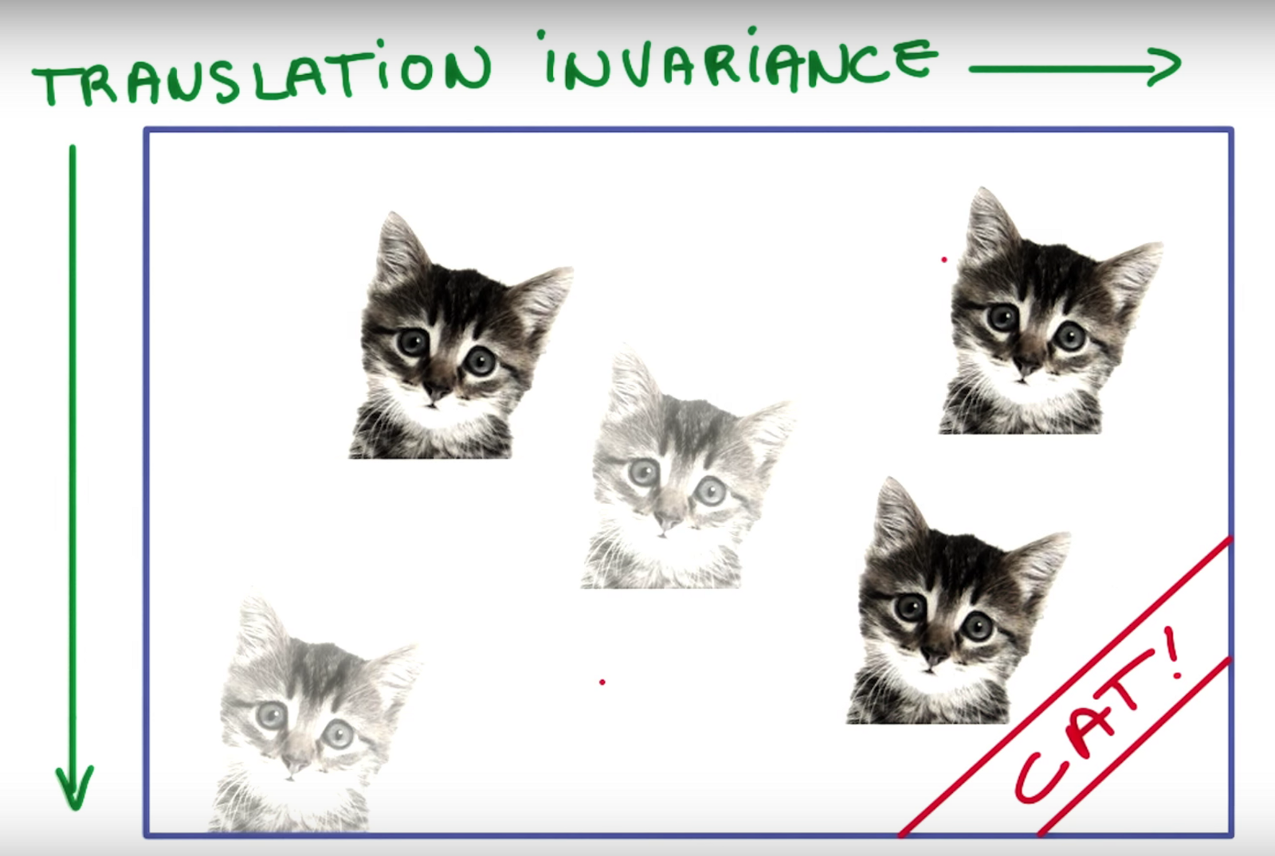
Advantage - Translation Invariant
As the convolution filters are “sliding” over the input image, the exact location of the object we want to find does not matter much

Slide 4

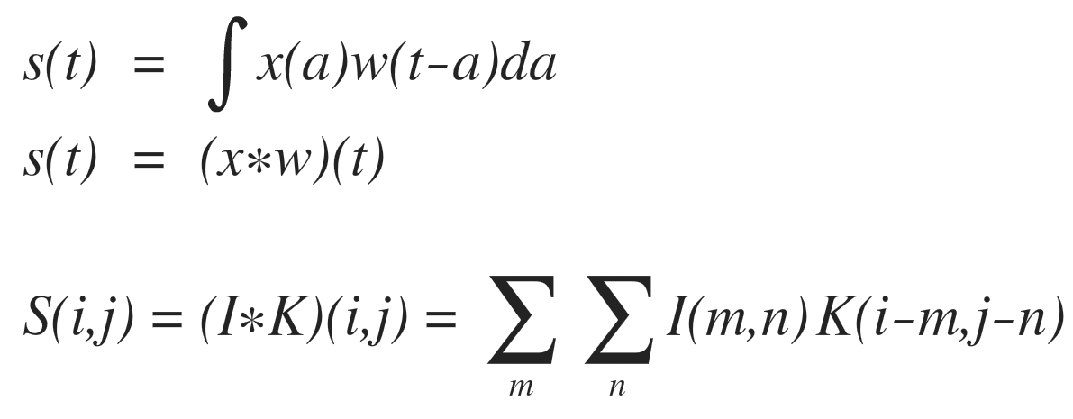
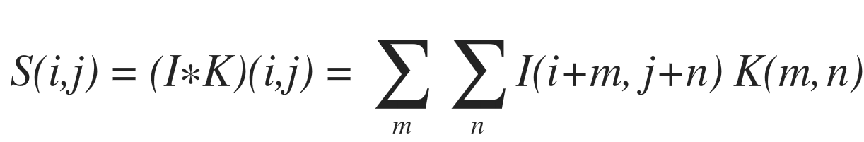
Convolution
In signal processing
In machine learning

Slide 5
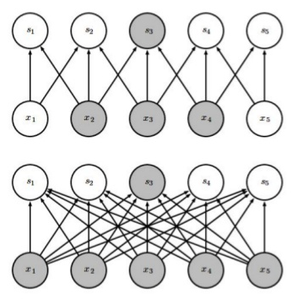
Convolution
Features
Sparse interaction
Kernel is smaller than input
sparse
We can detect small, meaningful features such as edges
Reduces computational & memory requirements
Improves statistical efficiency
dense

Slide 6
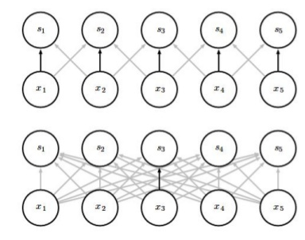
Convolution
Features
Parameter sharing (tied weights)
Using the same parameter for more than one function in a model
CNN
Less memory require for weights than FC
It causes the layer to have a property of
equivariance to translation
- If the input changes, the output changes in the same way.
It is useful for detecting edge in an image
FC

Slide 7
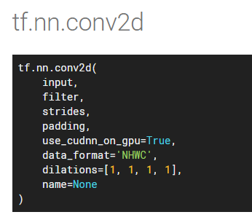
Convolution
Padding
Stride
Channel
conv_w = tf.Variable(tf.random_normal([3,3,1,16], stddev=0.1))
conv_layer = tf.nn.conv2d(input, conv_w, [1,1,1,1], ‘SAME’)

Slide 8
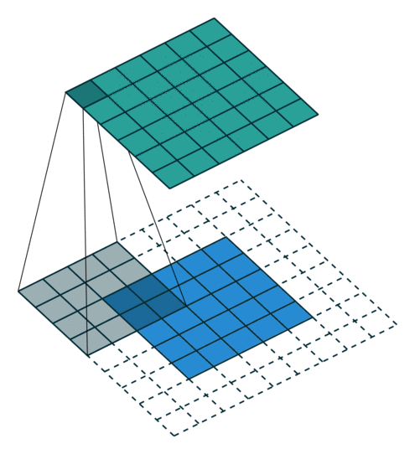

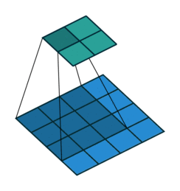
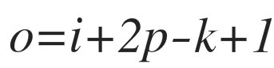
Zero-Padding
“VALID”
“SAME”
“FULL”

Slide 9


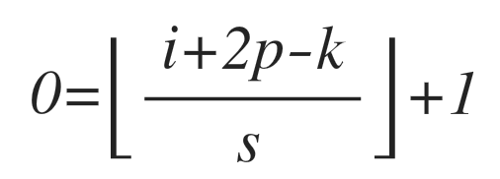
Stride
5x5 → 2x2
5x5 → 3x3

Slide 10

Channel
Total parameter : k_height x k_width x in_channel x out_channel
3
3
3
X #output channel

Slide 11
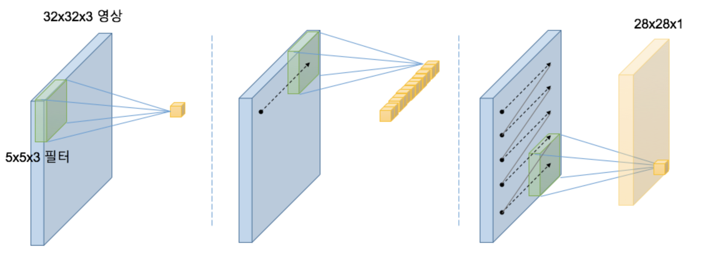
Channel

Slide 12
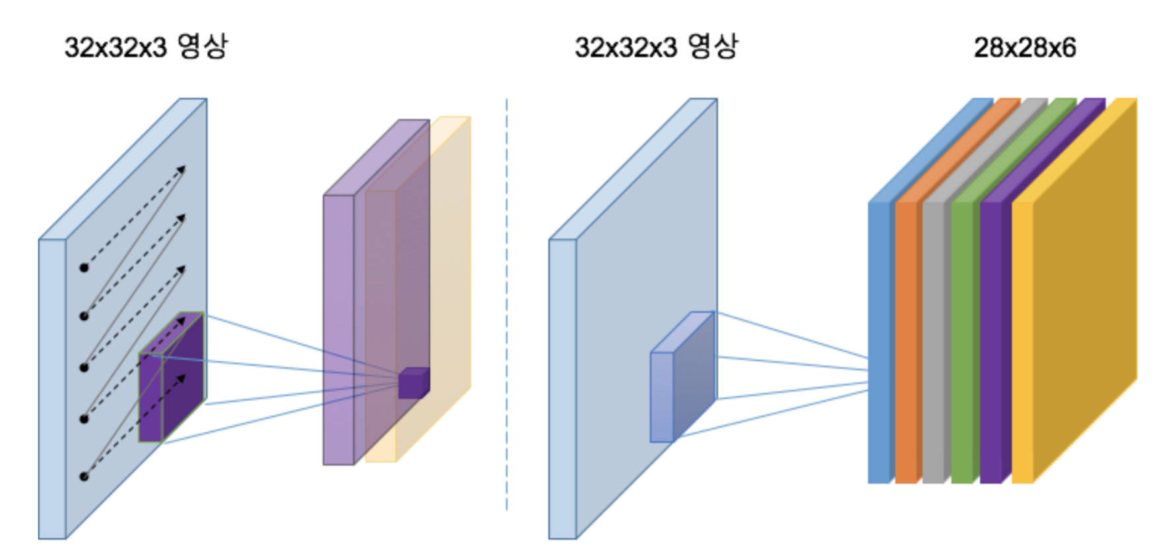
Channel

Slide 13

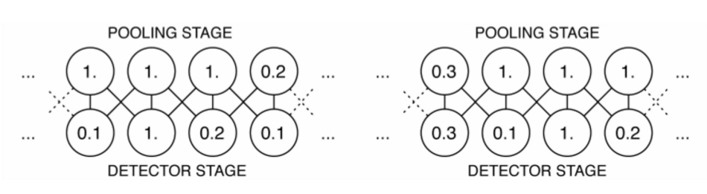
Pooling
Reduce representation size
low computational & memory cost
low statistical burden on next layer
- Invariant to small translations
특정 feature의 정확한 위치보다
“존재 유무”가 더 중요한 경우,
invariance to local translation 이 유용.

Slide 14
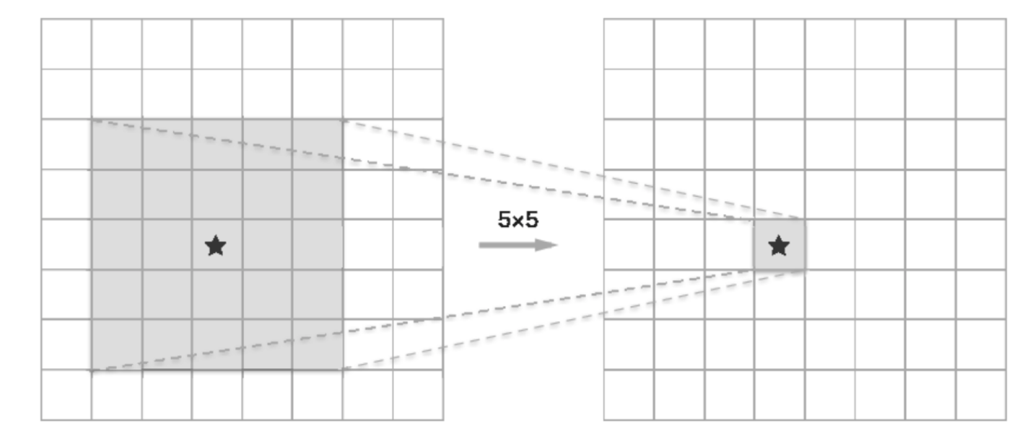
Receptive Field
output 한 점을 계산하는데 반영된 input 영역
( 3 x 3 ) x 2 vs. 5 x 5

Slide 15
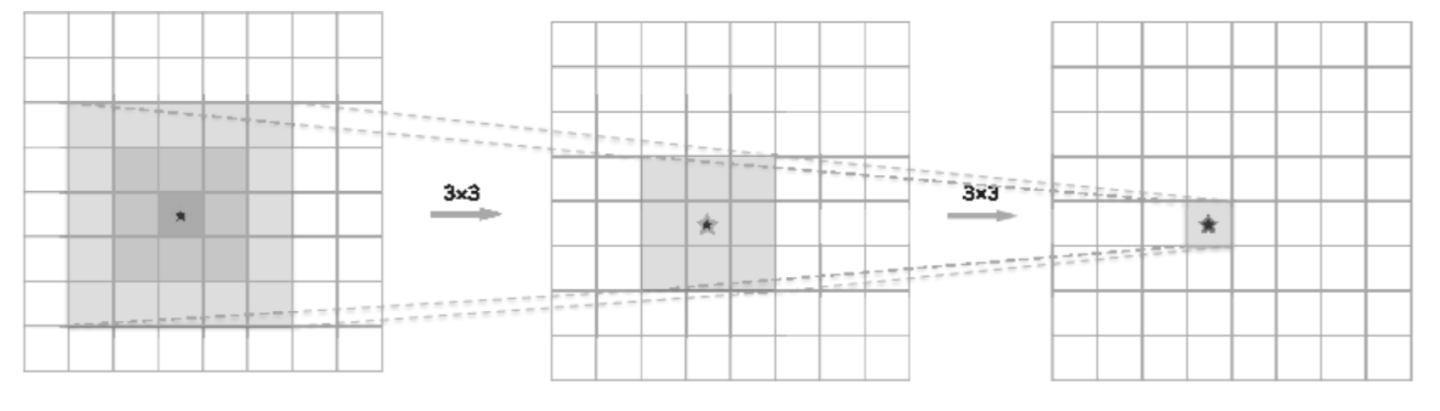
Receptive Field
Parameter: 25 vs. 18
Non-linear: 1 vs. 2

Slide 16
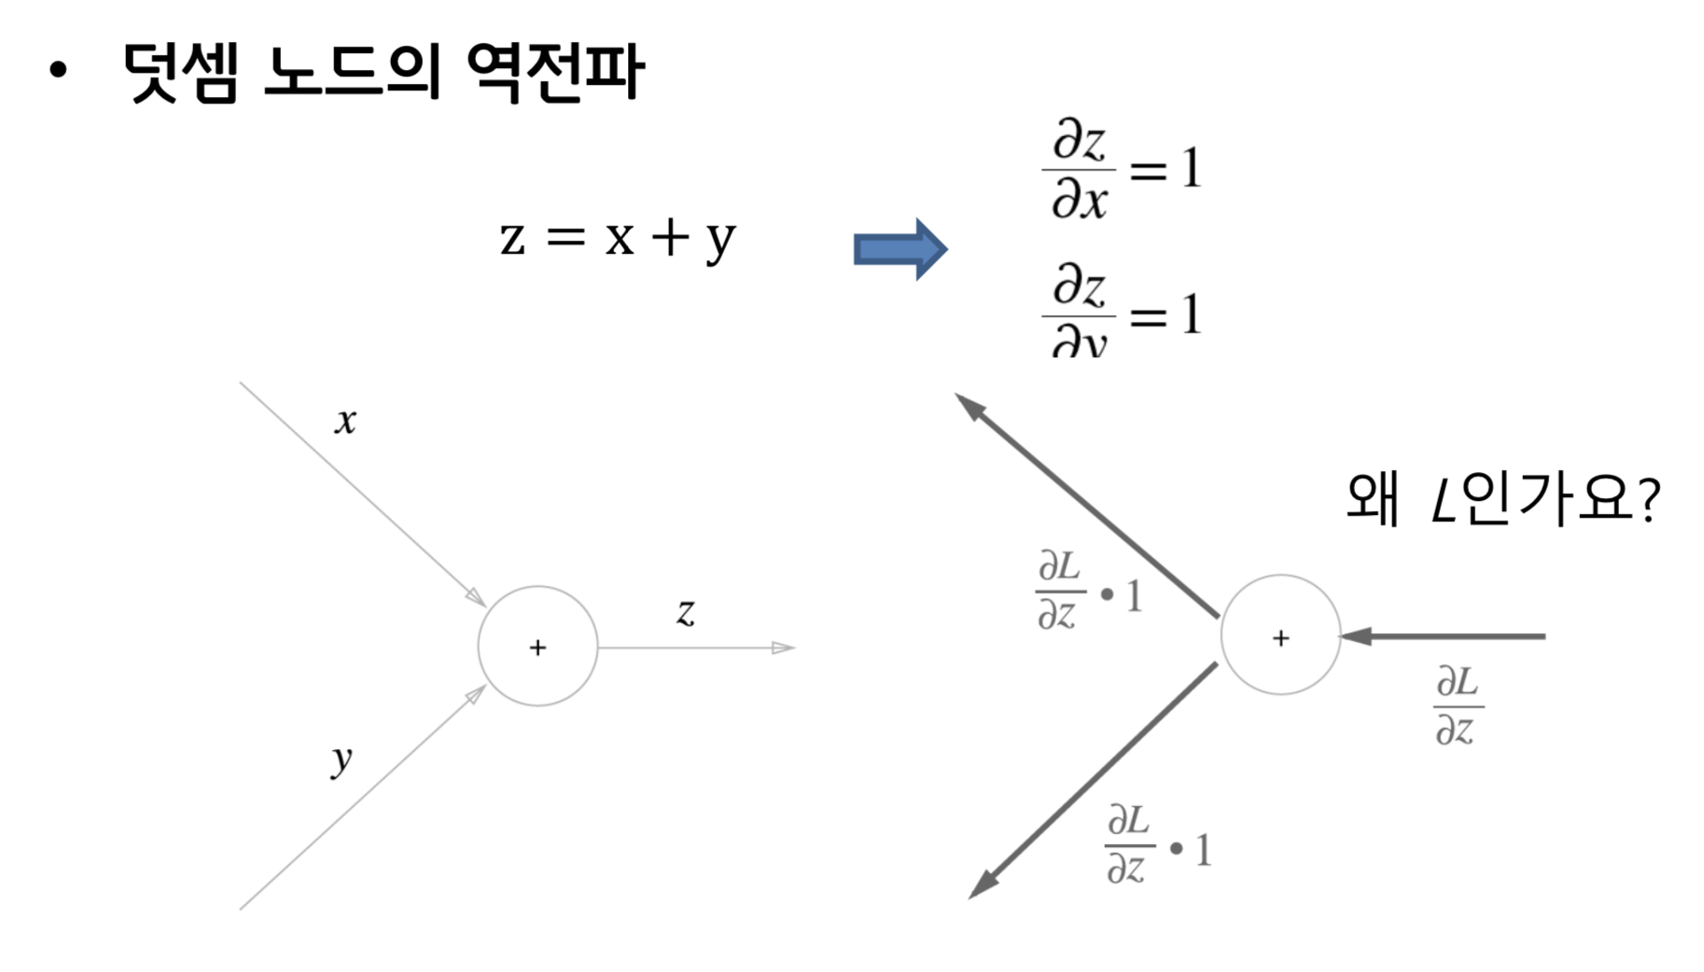
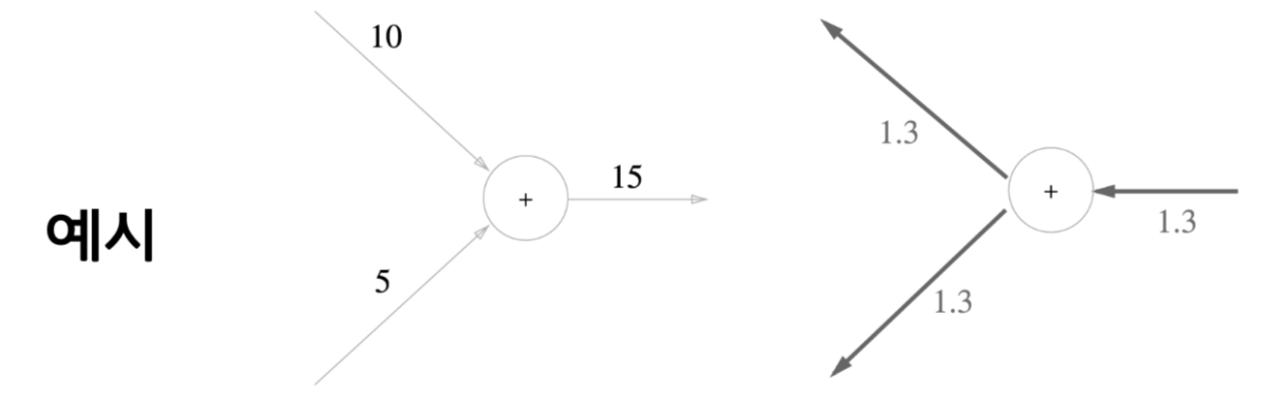
Back-propagation
Review

Slide 17
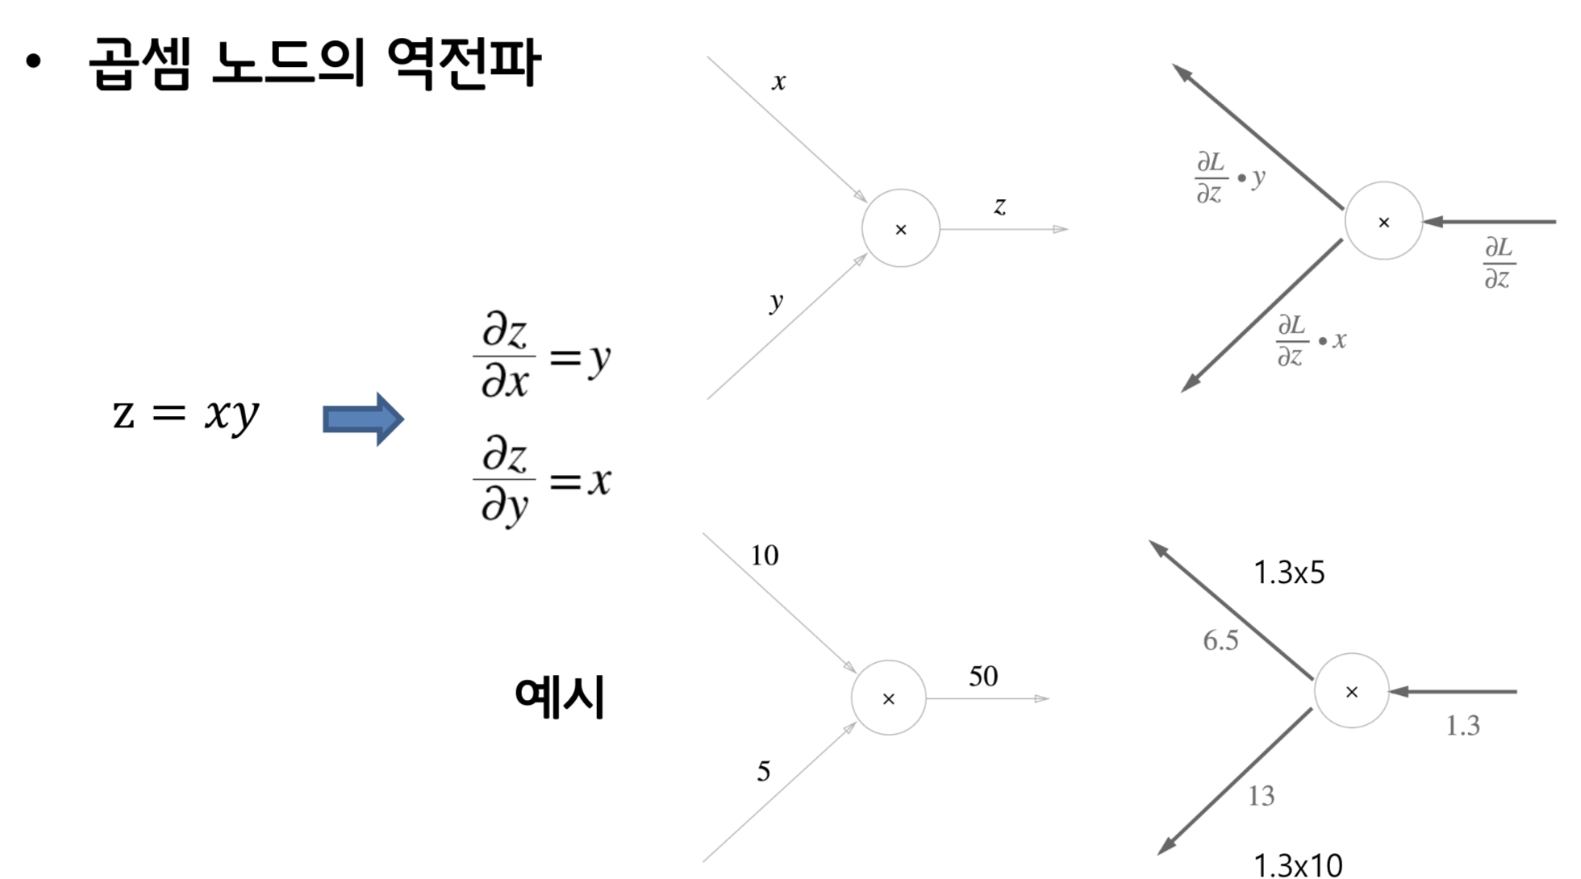
Back-propagation
Review
곱셈 노드의 역전파는 순방향 입력 신호가 필요함

Slide 18
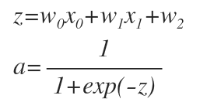
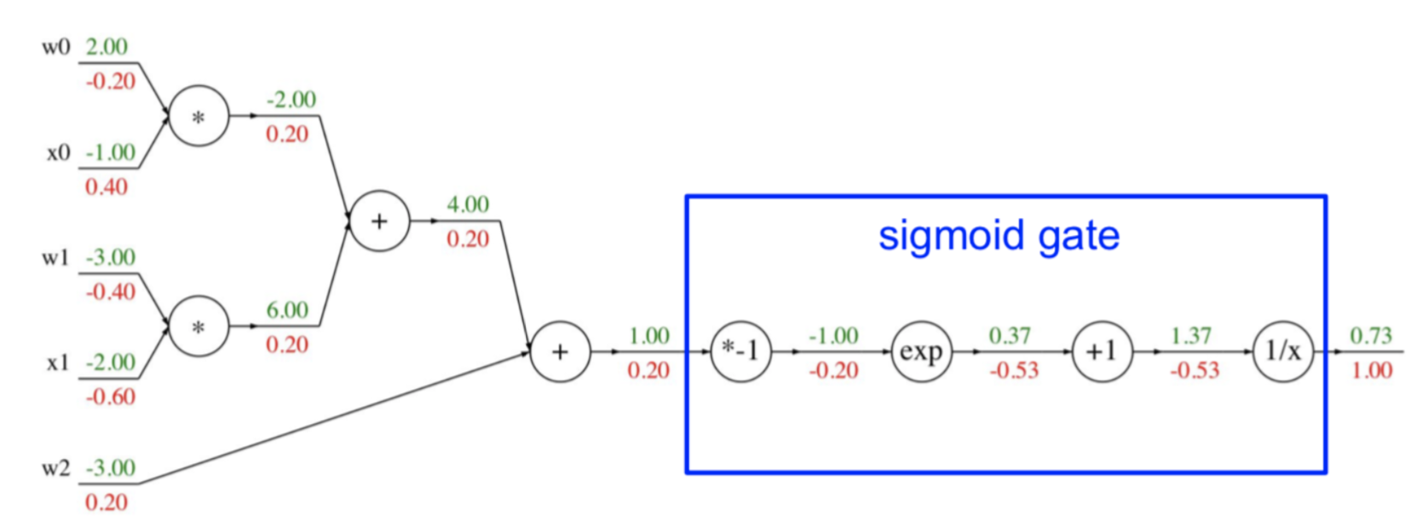
Back-propagation
Review

Slide 19
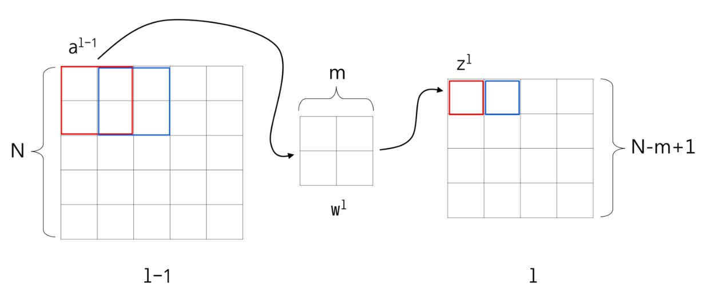
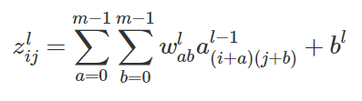
https://metamath1.github.io/cnn/index.html
Back-propagation

Slide 20
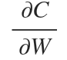
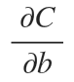
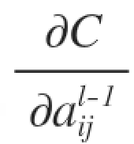
Back-propagation

Slide 21
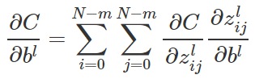
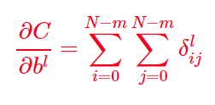
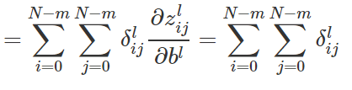
Back-propagation

Slide 22
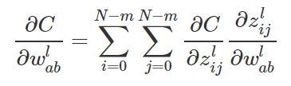
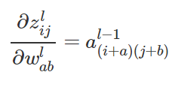
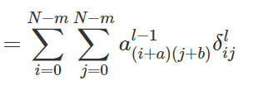
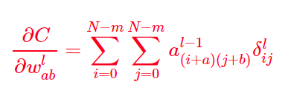
Back-propagation

Slide 23
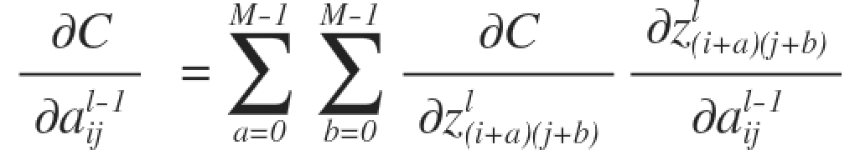
Back-propagation
Conv + pooling

Slide 24
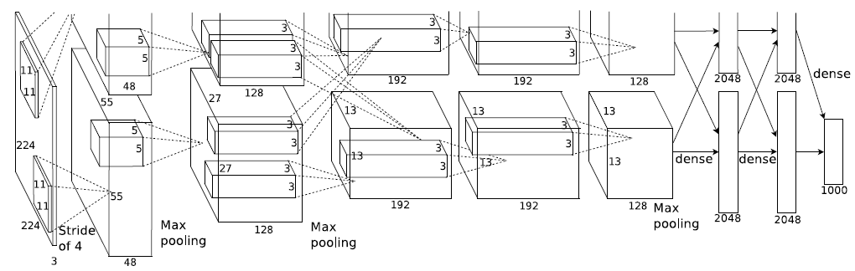
AlexNet
ReLU, DropOut, Data-Augmentation

Slide 25
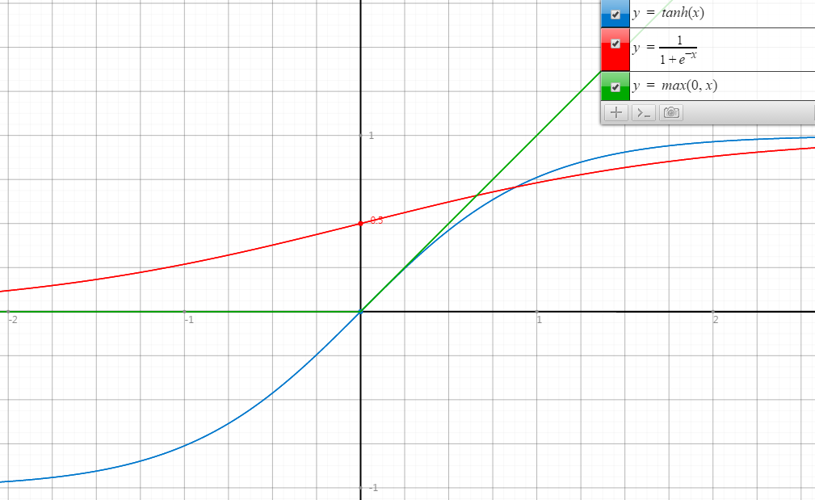
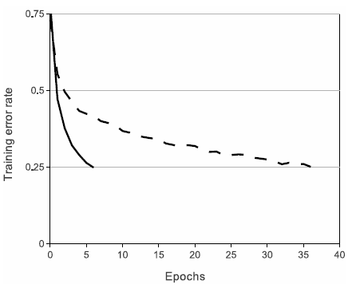
ReLU
Rectified Linear Unit
ReLU
tanh
Faster Convergence!

Slide 26
DropOut
Very efficient version of model combination
Making neuron cannot rely on the presence of particular other neurons.

Slide 27
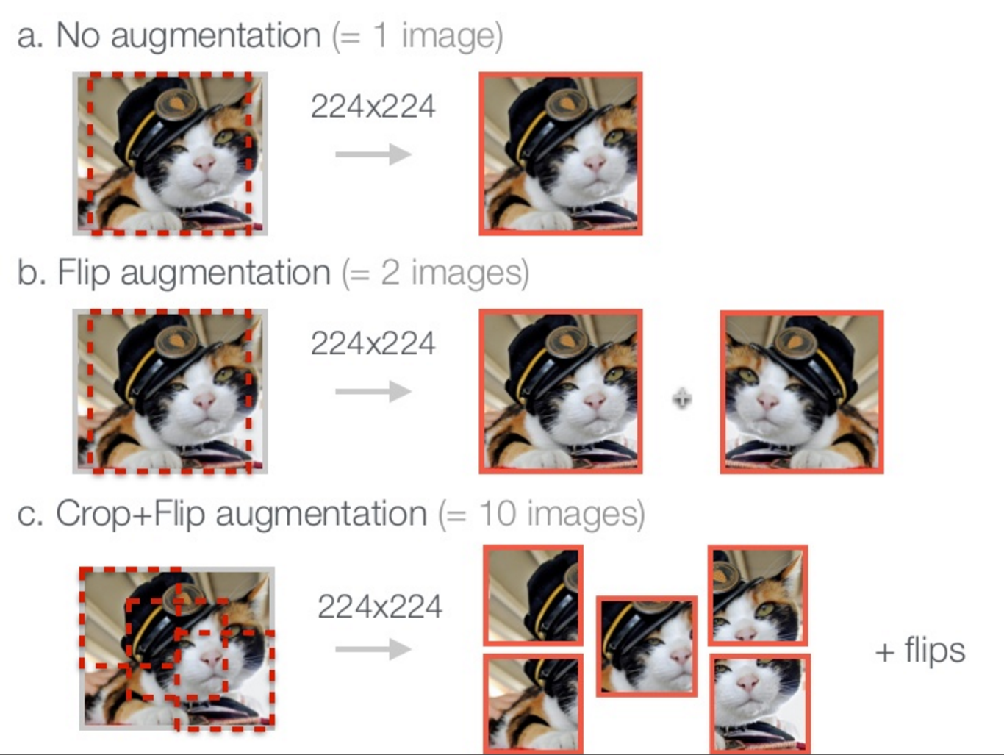
Data Augmentation

Slide 28
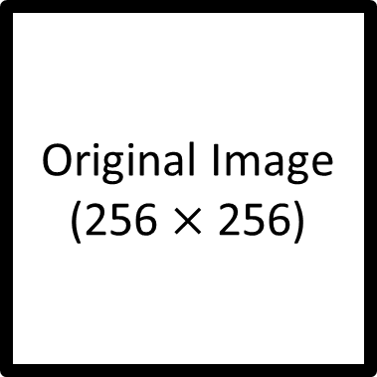
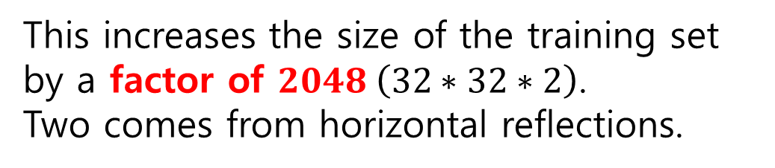
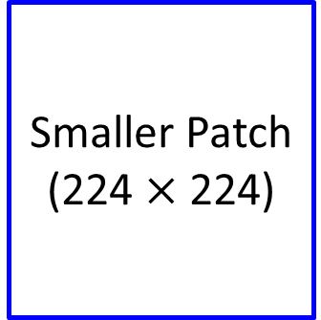
Data Augmentation
Original Image
(256 $×$ 256)
Smaller Patch
(224 $×$ 224)
This increases the size of the training set by a factor of $2048 \left(32∗32∗2\right)$.
Two comes from horizontal reflections.

